Slide 1
C.M.S. Redefined: Cloud. Mobile. Social.
CMS Expo 2012
Chicago, IL
May 9, 2012

Slide 2
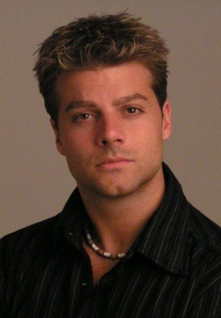
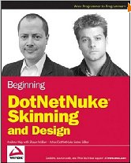
Presenter
Shaun Walker
Co-Founder & CTO
DotNetNuke Corporation
- 20 years professional experience in architecting and implementing enterprise software solutions for private and public sector organizations.
- Creator of DotNetNuke, a Web Content Management Platform for Microsoft .NET which is the Largest and Most Successful Open Source Project native to the Microsoft Platform
- Served as a founding Director for the Outercurve Foundation, a non-profit foundation created in 2009 by Microsoft Corporation for enabling the exchange of code and understanding among software companies and open source communities.

Slide 3
Industry Trends…

Slide 4
Content Management System Maturity

Slide 5
One Thing is Certain… The Future Is Uncertain…
2020
????????
2010
Communication Age
Dynamic – Push & Pull
Growth
2000
Information Age
Static - Push
One-to-Many
Many-to-Many
Multi-Dimensional
Time

Slide 6
Globalization
Outsourcing
Globalization
Commoditization
Differentiation
Specialization
Resource Reallocation
Outsourcing
“Consumerization of Technology”
Always Connected
Broadband Infrastructure
High Speed Mobile Devices
Virtualization

Slide 7
Emergence of Collaborative Business Networks
“The World is Flat”
Business is no longer hierarchical or vertical
It is interconnected and horizontal
Requires superior collaboration, coordination, and communication
Greater emphasis on relationships and interactions

Slide 8
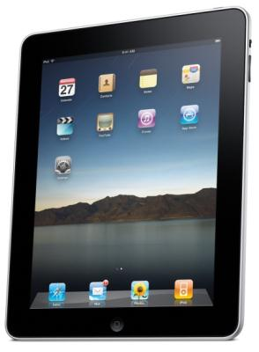
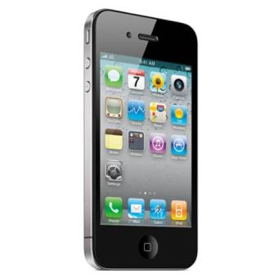
Systems of Engagement
Morgan Stanley estimates that by 2015, the mobile web will be bigger than desktop internet.
150 million
Mobile
800 million
300 million
Cloud
Social

Slide 9
Systems of Engagement Value Proposition
Shorter project cycles
Faster response time
Greater agility
Lower management overhead
Higher productivity
Improved communication
Cost effective

Slide 10
The Content Explosion

Slide 11
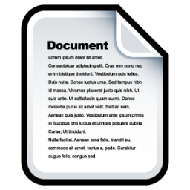
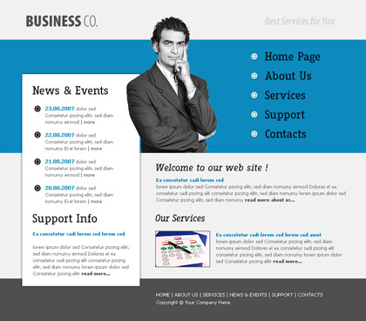
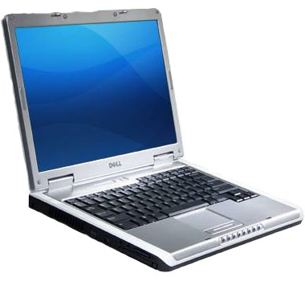
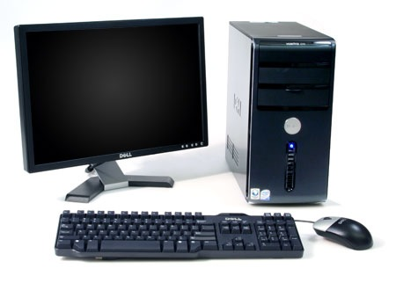
CMS 1.0

Slide 12
CMS 2.0
100M users
800M users
300M users
Cloud
Mobile Web
Social Web
Open Web
Open Web
Social Web
Mobile Web
Cloud
150M users
500M users

Slide 13
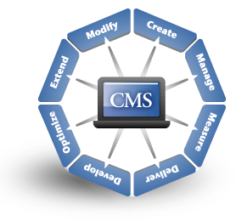
Your CMS is The Central Hub of Your Business

Slide 14
Systems of Engagement
Morgan Stanley estimates that by 2015, the mobile web will be bigger than desktop internet.
150 million
Mobile
800 million
300 million
Cloud
Social

Slide 15
CMS + Engagement = A Perfect Marriage

Slide 16
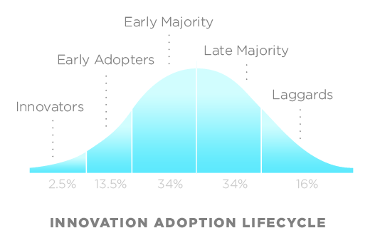
Adoption of Systems of Engagement (2012)
Customers want Technology
Customers want Solutions and Convenience

Slide 17
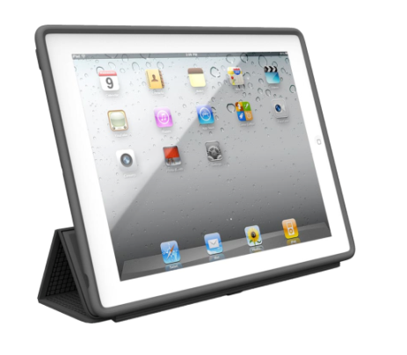
“C.M.S.” Redefined:
Cloud
Mobile
Social

Slide 18
Shaun Walker, CTO
DotNetNuke Corporation
@sbwalker

